Slide 1
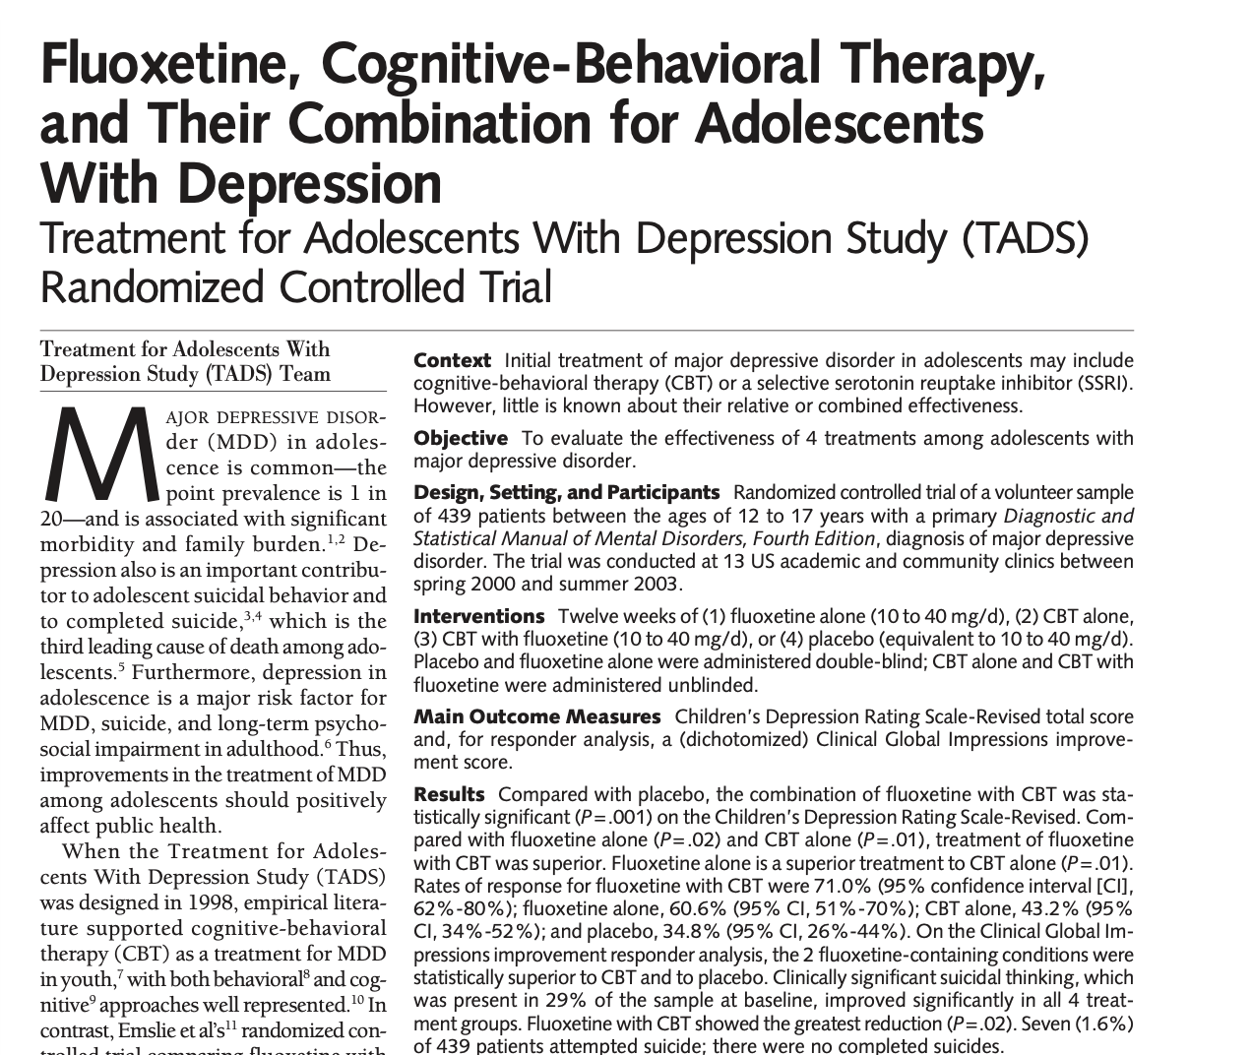
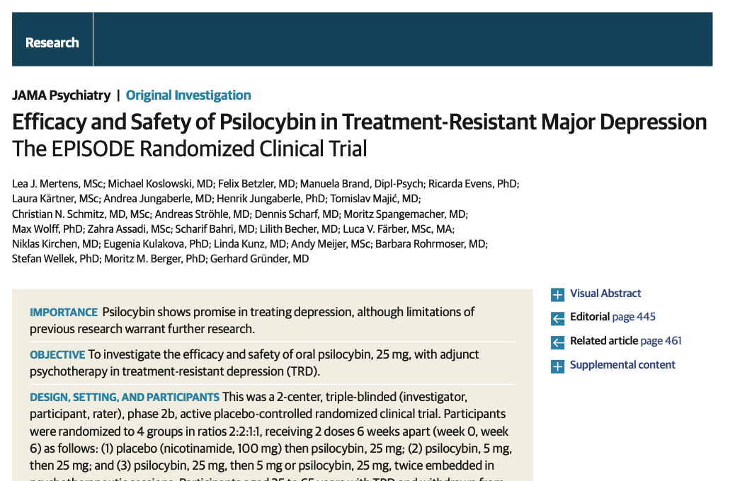
Reading 101
Steve White
Dr. Lane

Slide 2


guiding principles
Goal: be a good consumer of the literature
before
after

Slide 3
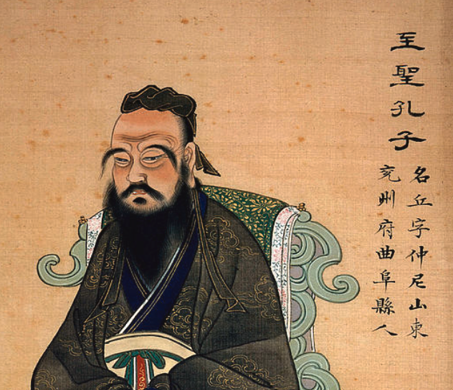
guiding principles
active learning
“Is it not pleasant to learn through constant perseverance and application?” – The Analects

Slide 4
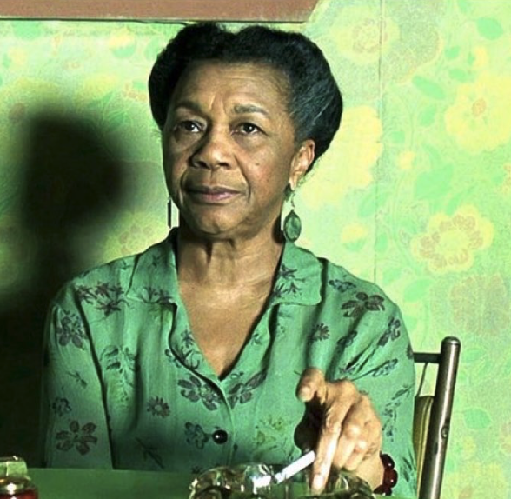
guiding principles
think!
“One repays a teacher badly if one remains nothing but a pupil” – Nietzsche

Slide 5
Outline
Is this study informative? (today)
How big is the effect? (August)
Other topics and applications (September)
Really two questions today:
Does the paper use methods that are valid?
Can I extrapolate the results from their population to people like my patient?

Slide 6
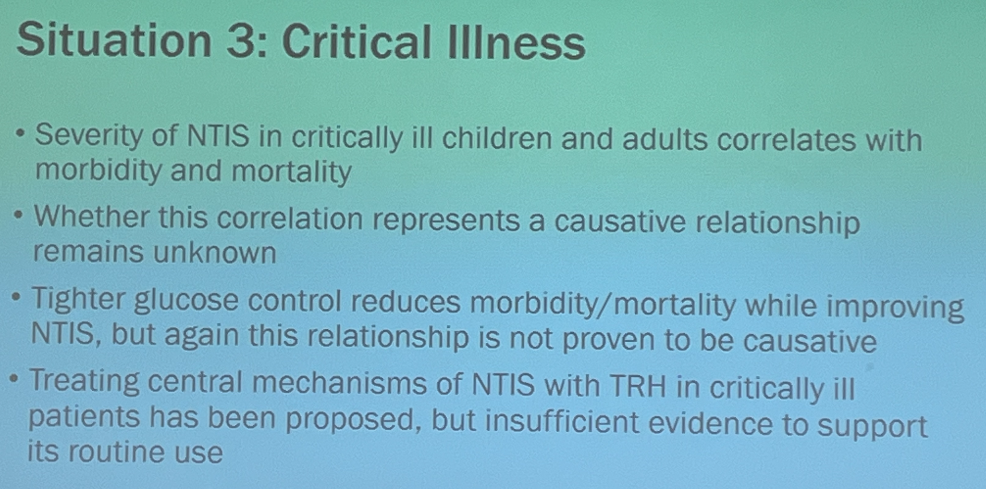
think-pair-share
from a Peds endocrine fellow’s presentation:
What does this mean?
NTIS = euthyroid sick syndrome, welcome to endo
Notes:
No one knows what this means, its completely incoherent

Slide 7
Counterfactual notion of causality
aka “But for” causation

Slide 8
Bad counterfactuals / “controls”
Most of the literature on treatments does some variation on this theme:
What’s the problem with this argument?
(Try to frame it in terms of our notion of causality.)

Slide 9
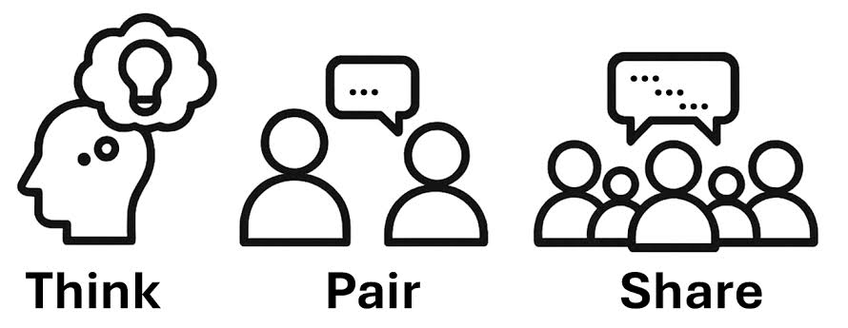
Observational studies
Pretty much all boil down to constructing some kind of plausible counterfactual.
Example: Twin studies. Compare group who went to college vs their identical twins who didn’t. Track health to see if education impacts health.
What do you think?
Notes:
Why did those twins not go to college if they were ”identical?” Maybe they had the same genes but seriously, what happened? Did twin B get a TBI playing football? Was twin B sexually assaulted in school? Isn’t it plausible that whatever difference cause twin B’s life to go off the rails in high school is the reason for the differences later in life, not just that twin A went to college.

Slide 10

the problem with observational studies
People choose to get treatments
➔ choices happen for reasons
➔ these reasons are almost always a more plausible explanation for the group differences
There are some clever, maybe convincing types of observational study designs that are beyond our scope.

Slide 11
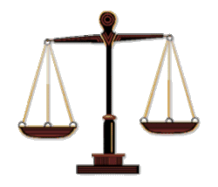
randomization
Randomization lets you create a good counterfactual
If treatment is allocated randomly then
no confounder differs between the groups (on average)
= prognostic balance
treatment
group
control
group

Slide 12
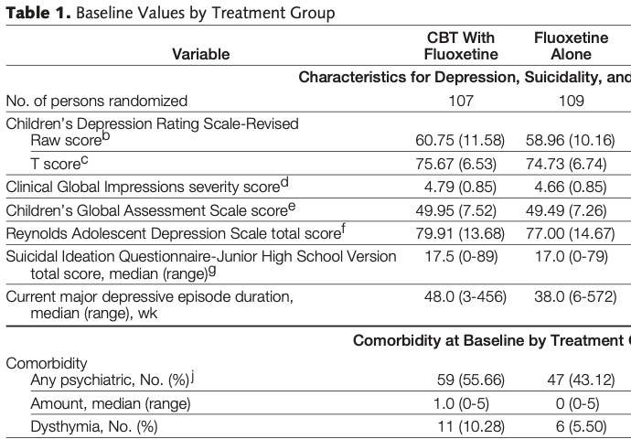
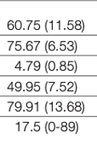


“Table 1”
Every randomized trial has a table one to illustrate prognostic balance. Let’s look at one.
Source: TADS
Notes:
The real table is hidden behind the identical #s, just a fun way to not its AVERAGE balance, not identical

Slide 13
Dealing with crossover
in randomized trials some people in the treatment group will refuse to take the pill and some people in the control group will get their hands on the treatment.
Which is the better approach?
1. compare outcomes of everyone using original assignment groups
2. compare outcomes of people who followed the protocol (treatment who got treatment, control who didn’t, exclude people who crossed over)

Slide 14
1. compare outcomes of everyone using original assignment groups (intent to treat) ✔️
2. compare outcomes of people who followed the protocol (treatment who got treatment, control who didn’t, exclude people who crossed over) (per protocol analysis)
Does this have prognostic balance?
NO!
Notes:
I think this is the easiest way to see why per protocol is junk, throwing out data causes you to lose prognostic balance which means you’re defeating the whole point of randomization

Slide 15
Practical problems #1: attrition
People leave the trial . . . you lose prognostic balance.*
Old heuristic: 5-20 rule
- attrition difference of >5% is bad
- total attrition >20% is bad
Solutions?
Only analyze data for people who complete the trial?
Carry last observation forward?
Use “mixed-effects models for repeated measures” ✔️
* = unless they leave at random from both groups
Notes:
Don’t expect to go into any depth here, just know that’s the current accepted method; not something I have ever used myself or know that much about; I’ve done multiple imputation and think that and bounding methods make sense but are way too complicated

Slide 16
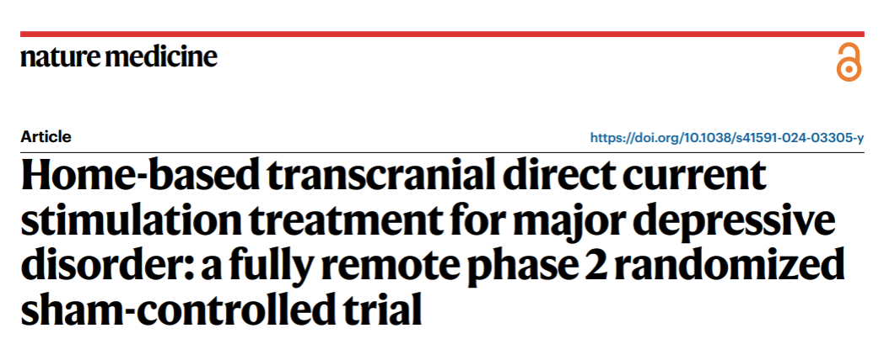
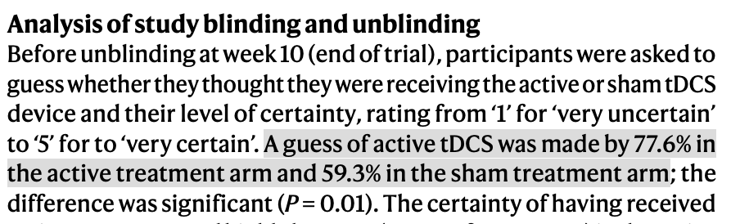
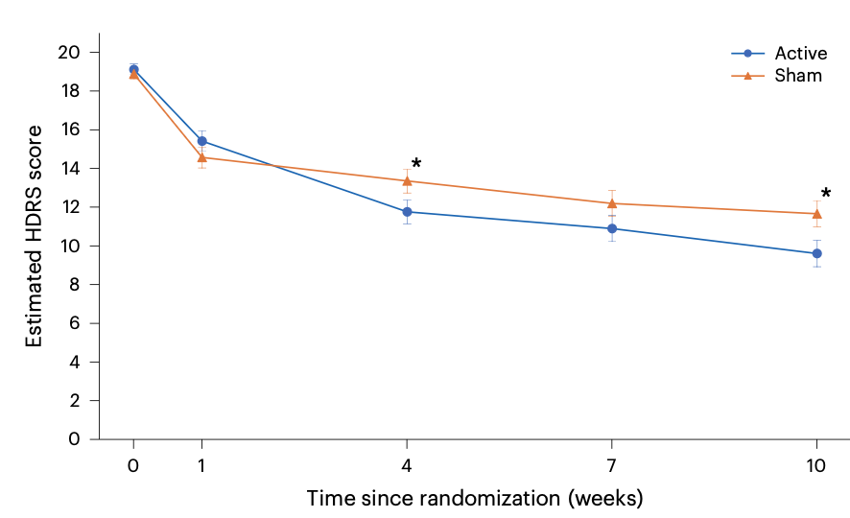
Practice issue #2: lack of blinding
Discussion: is this a common issue in CAP?

Slide 17
external validity
So far we’ve focused on internal validity – is the paper giving a good estimate for the kinds of people they studied….
But your question is about YOUR patient.

Slide 18
Population (who?)
Intervention (what?)
Comparison (alternative tx, often placebo)
Outcomes
Take ____ minutes to read through the example and do your best to characterize the population. Does it seem representative of the kids you treat?
Notes:
Made a handout and will make 20 print outs of the methods part of on a simple study that I’m familiar with (the TMS for adolescents one)

Slide 19
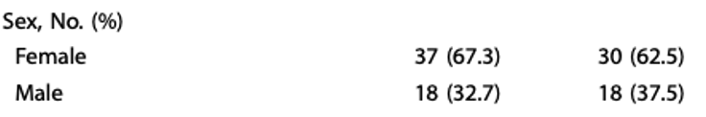
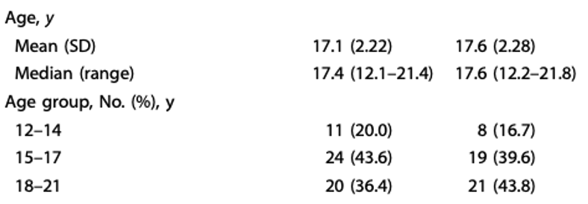
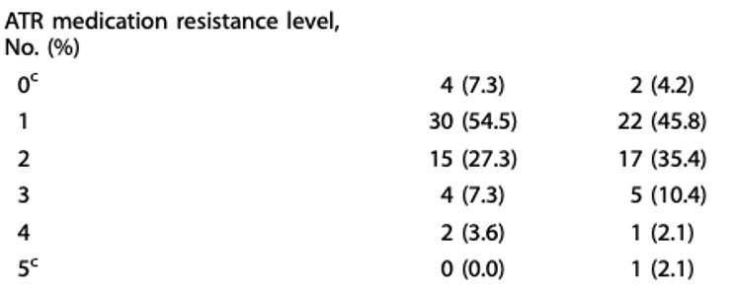
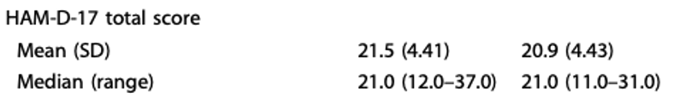
Some population features
HAM-D-17 scores tend to be a little higher than PHQ-9 scores

Slide 20
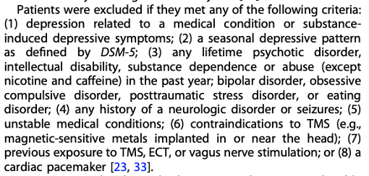
exclusion criteria
Get in the habit of looking at these
No cardiac pacemaker….
No PTSD, eating d/o, substance dependence . . .

Slide 21
A new treatment for anxiety
Notes:
The point here is (1) don’t forget about time, beer (and alprazolam and quetiapine) work great short term for anxiety, but GAD is a chronic disease so presumably the study should have long-term f/u and (2) [if there is time to discuss] also raises issue of symptomatic outcomes vs functional, beer helps with anxiety symptoms but not with function. Plus this is funny so people remember it.

Slide 22
PICO-T
Population (who?)
Intervention (what?)
Comparison (alternative tx, often placebo)
Outcomes
Time of follow-up
What is a reasonable duration of follow-up for a tx for GAD?
How long do GAD sxs typically last?

Slide 23
Summary
Causation, know what it is, don’t be the endo fellow
Observational studies are mostly not probative
Randomization yields prognostic balance
But watch out for non-random attrition and unblinding
A good study on population X might not tell you much about how the treatment impacts population Y
Look at exclusion criteria in every study
PICOT

